Slide 1

Transform the Classroom with Collaborative Technologies!
Brainstorm 2012
Sessions ID - Break-1842

Slide 2
Session Information
Presenters:
  Craig Staffin – Managing Consultant Core BTS
  Lora Mathison – Technology Director – IASC
  Steve Randall – Network Administrator – IASC

Slide 3
What is IASC?
IASC stands for Itasca Area Schools Collaborative
  Comprised of 7 K-12 Schools Districts & one Community College
  The largest school district has approximately 3,750 students enrolled.
  The smallest….. Only 390 students!!

Slide 4
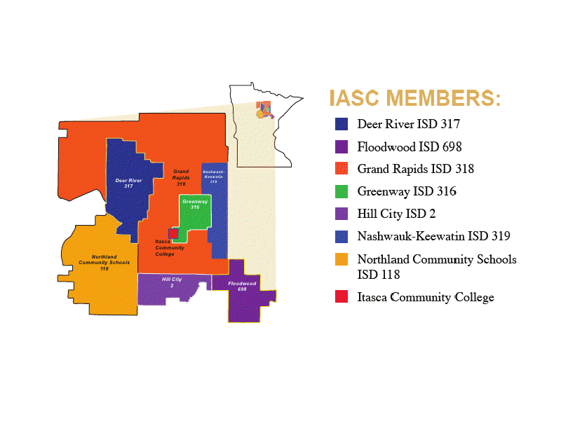
Where is IASC located?

Slide 5


Education 3.0 Transformation Framework
1
Need
for Change
District realizes its students are not prepared for the 21st century.
2
Vision
Setting
Educators and community work together to paint a picture of what education should look like.
3
Scan
the System
Identify areas/gaps where reality and vision are far apart.
4
Plan
for Action
Faculty and leaders work with each other and outside experts to develop concrete plans to close each gap.
5
Adopt
the Plan
Leaders communicate the plan, build support in the community, and get final approval.
6
Implement
the Plan
Invest in technical and educational infrastructures needed to support transformation plan. Develop ability of faculty, students, and staff to teach and learn in new ways.
7
Monitor
and Refresh
Track progress of transformation process and refresh/revise as needed.
Need
for
Change
Vision
Scan
Plan
Adopt
Implement
Monitor
and
Refresh
Notes:
What the consultancy offer should be
4 area –
Policy
System leader
Cio
School leader/ Teacher

Slide 6
IASC Continued Vision
Access, Align, Build
2014/15
Community Partnerships 2013/14
Teaching/Learning 2012/13
Core Infrastructure 2011/12
Vision Next Steps
2015/16

Slide 7
IASC Technology
IASC shares a common Fiber backbone between all schools. This allows for sharing of resources such as:
  Centralized Cisco VoIP
  Centralized WiFi
  Centralized Video Deployment
  Centralized Servers and storage

Slide 8
IASC Network Layout

Slide 9
How to change the classroom
Adding in collaborative technologies to expand the classroom experience.
IASC deployed 3 Cisco TelePresence rooms in phase 1
Teaching Ojibwa and Spanish over TelePresence

Slide 10
Why Cisco TelePresence?
TelePresence was chosen for its “lifelike” video capabilities
Allows for seamless interaction between teacher and student
Ability to teach over great distances while still keeping the students are teacher engaged

Slide 11
What did Phase 1 Look like?
3 Cisco TelePresence 3210 Rooms (18 seat rooms)
Cisco Communications Manager
TelePresence Multipoint Switch

Slide 12
TelePresence Project
Each Cisco TelePresence room arrives on 14 separate pallets totaling roughly 3000 pounds
Each room takes roughly 5 days and 2 engineers to assemble
Building considerations (Power, HVAC, Logistics)

Slide 13
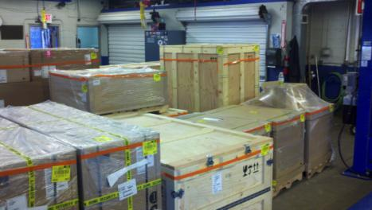
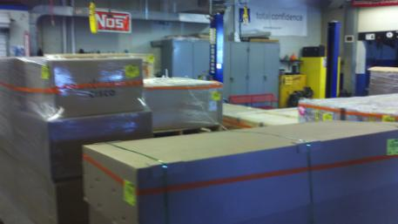
These turn into……

Slide 14
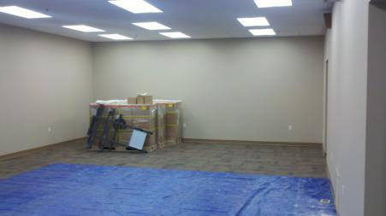
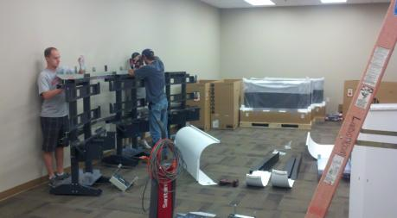
More than hardware and……

Slide 15
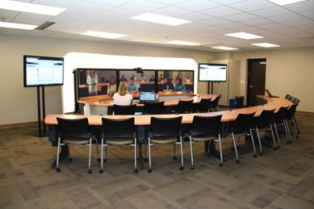
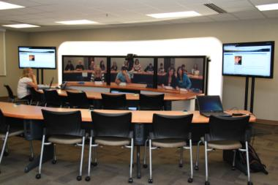
So much more than a room!!

Slide 16
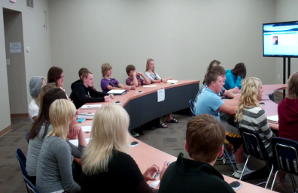
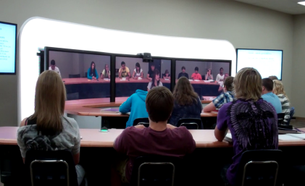
Changing teaching & learning!

Slide 17
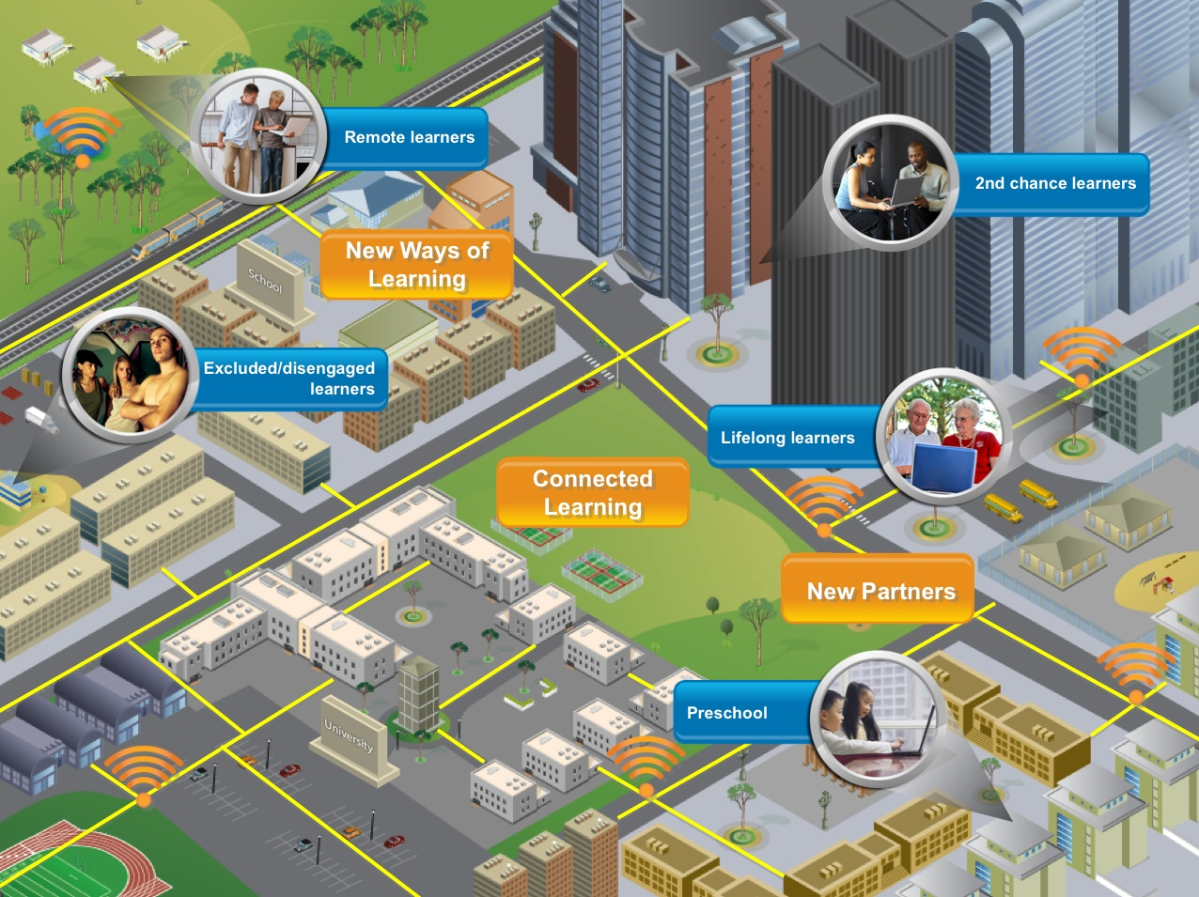
IASC Continued Vision
Access, Align, Build
2014/15
Community Partnerships 2013/14
Teaching/Learning 2012/13
Core Infrastructure 2011/12
Vision Next Steps
2015/16

Slide 18
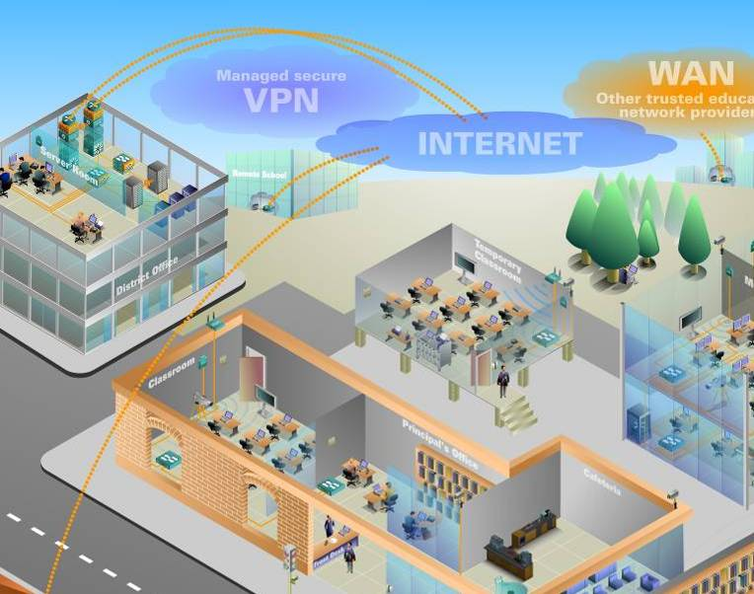

The Power of Architecture Convergence
The power of a Network
.
Data Arch
Collaboration
Arch
Network
Arch
Vocabulary
Arch
IASC Network (Community)
Organization
Arch
Financial
Arch
?????
????

