Slide 1

The impact of technology on education in a regional collaborative and our collective future

Slide 2
Members
Deer River ISD #317
Grand Rapids ISD #318
Greenway ISD #316
Nashwauk-Keewatin ISD #319
Floodwood ISD #698
Northland Remer ISD #118
Hill City ISD #2
Itasca Community College

Slide 3
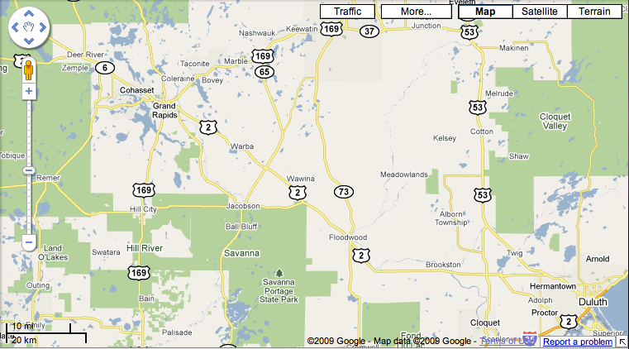


Slide 4
Collaborations
Technology
Community Education
Curriculum
Interactive Television
Invest Early Initiative
Vocational Technical
Staff Development
Online Learning
Business Services
Transportation
Special Education
Administrative Services
Printing
Bricks and Mortar
Data Warehouse Solution

Slide 5
Technology’s Role
Current
Near Future
Not-so-distant future

Slide 6
National Educational Technology Standards
1. Creativity and Innovation
  Students demonstrate creative thinking, construct knowledge, and develop innovative products and processes using technology.
2. Communication and Collaboration
Students use digital media and environments to communicate and work collaboratively, including at a distance, to support individual learning and contribute to the learning of others.

Slide 7
National Educational Technology Standards
  3. Research and Information Fluency
  Students apply digital tools to gather, evaluate, and use information.
4. Critical Thinking, Problem Solving, and Decision Making
Students use critical thinking skills to plan and conduct research, manage projects, solve problems, and makeinformed decisions using appropriate digital tools and resources.

Slide 8
National Educational Technology Standards
  5. Digital Citizenship
  Students understand human, cultural, and societal issues related to technology and practice legal and ethical behavior.
6. Technology Operations and Concepts
Students demonstrate a sound understanding of technology concepts, systems, operations.and resources.

Slide 9


Slide 10
Implications of Improving technology
Work anytime
Work anywhere
Work with anyone
Work that is meaningful
Global competition

Slide 11
Implications of Improving technology
Learn anytime
Learn anywhere
Learn with anyone
Learning that is meaningful
Global competition

Slide 12
Requirements
Access
Affordability
Redundancy
Speed

Slide 13

Matt Grose
Superintendent, Deer River ISD #317
Chair, IASC
218-246-2420
mgrose@deerriver.k12.mn.us

