Slide 1
Accommodations and Modifications Training
Aug. 21, 2018 - All District Sped Day

Slide 2
Today’s Agenda:
Modifications and Accommodations - What is the difference?
Decision Making
Carry out and follow through of accommodations
Tracking and Modifying

Slide 3
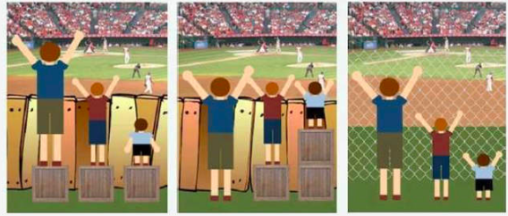
Critical Thinking…. What do each of these represent in the educational setting?
1. The baseball game 2. The wooden fence 3. The boxes.
Take a minute to look at these pictures of children watching a baseball game.
Keep these pictures in mind - we will come back to this in awhile.

Slide 4
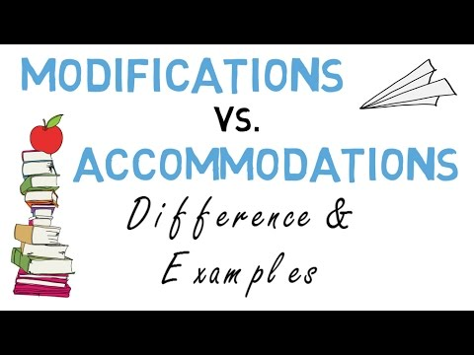
Modifications vs. Accommodations - how they differ

Slide 5
Definitions of Modifications and Accommodations
Accommodations:
Reduce or eliminate the effects of a student’s disability.
Practices and procedures in the areas of presentation, response, setting and timing/scheduling that provide equitable access to grade level content for students with special needs. Changes in HOW they learn.
Assessment and instructional accommodations should not differ. ***
Modifications:
Practices that change, lower, or reduce the learning expectations, outcomes and materials.
Modifications are changes in WHAT a student is expected to learn. The changes are made to provide a student with opportunities to participate meaningfully and productively along with other students in classroom and school learning experiences.

Slide 6
Examples of Accommodations and Modifications
Modifications:
Learn different material/curriculum than grade level peers
Be excused from projects or assignments
Graded on IEP goals and objectives
Have a different class tests than grade level peers
Take alternate State Assessments
Accommodations:
Preferential Seating
Audio Books
No time limit on testing
Large Printed Materials
Closed Captioning
Voice word processor
Calculation Device
Visual organizers
Notes given to student
Study Carrel

Slide 7
Who decides on Appropriate Accommodations ?
The IEP team for the student -during the evaluation and during the IEP meeting.
-Parents of the student
-The Student
-Special Education Teacher(s)
-General Education Teacher(s)
-Administrator(s)
-Other related service providers (OT,PT, Speech)
Decision making of accommodations is a collaborative team effort. Accommodations occur across all settings in the school. All members need to be present for the IEP meetings.

Slide 8
Deciding on Appropriate Accommodations and Modifications
Some of the DON’Ts in Decision Making:
*Make accommodations solely on the disability
*Make accommodations unrelated to needs found in evaluation
*Make accommodations “as needed” or “when requested”
*Check off every accommodation listed on a checklist
*Use the same accommodations for every student

Slide 9
Deciding on Appropriate Accommodations and Modifications
Some of the DOs in decision making:
*Make decisions based on individual needs (things they need consistently)
*Be specific about Who, When, Where, How
*Select based on increased access to instruction
*Look at needs for instruction vs. assessment
*Get input, track and revise as needed

Slide 10
Minnesota Manual of Accommodations
For Students with Disabilities in Instruction and Assessment
Page 33 -Tool 2.1 Inclusion Needs that may Require Accommodations:
29 questions for the team to answer in the categories of:
* Student Characteristics
* Characteristics Affecting Setting Accommodations
* Characteristics Affecting Timing and Scheduling
* Language Characteristics That May Not Be Related to A Disability ( ELL)
***Uploaded on Resources page***

Slide 11
Answering “YES” on the Questionnaire
Next Step - Go to “A” table ( or whichever table given for that question)
-There are a total of 13 separate tables:
-Each table is broken into Characteristics of the disability
-Each table has two separate accommodation categories
1. Presentation
2. Response
There are accommodations listed that MAY be considered for that student to access grade level content (handouts)

Slide 12
Implementing the Accommodations and Modifications
The student’s IEP case manager is responsible for:
Making sure the IEP accommodations and modifications are correctly written in the student’s IEP.
Ensuring all members of the IEP team ( and all professionals working with the student) are given a copy of the accommodations and modifications to be followed in the educational setting. * letting them know of changes*
Ensuring all members of the IEP team understand how to use and implement the accommodations and modifications in the educational setting.
4. Ensuring all assistive technology and other materials are given to teachers in order to implement the accommodations and modifications.

Slide 13
Implementing the Accommodations and Modifications
The student’s classroom teachers are responsible for:
Attending and participating in the IEP meeting and helping make decisions.
Reading through the student’s accommodations and modifications on the final IEP and ensuring they have everything needed to carry them out in the classroom.
Using the accommodations and modifications consistently.
Tracking the accommodations and modifications to ensure they are appropriate for the student. ( IEP manager will help with tools to track)
Communication with the IEP manager in the effectiveness of the accommodations and modifications.

Slide 14
Using, Tracking and Modifying Accommodations
Other materials available in the Minnesota Manual:
Accommodations From the Student Perspective
Accommodations Journal ( for student)
Parent Input in Accommodations ( handout for parents)
Tool 2.5 - Accommodation Use in the Classroom
Tool 2.6 - Evaluating Accommodation Use in the Classroom
** *Uploaded on Resources Page***

Slide 15
Tool 2.5 - Accommodation Use in the Classroom
Chart to track different aspects of how a student uses an accommodation in your classroom.
-Helps with decision making
1. Is it written in the IEP?
2. For what task is it being used?
3. Does the student use this every time ( note how often)?
4. Does it need to be fixed or changed?
5. Does the student use this alone or with assistance?
6. Notes: More effective used on some tasks etc.?
***Uploaded on Resources Page***

Slide 16
Tool 2.6 - Evaluating Accommodation Use in the Classroom
Using the information from the chart in 2.5
Consider the following questions:
There are 4 questions to consider.
There is a “Student Accommodation Use Tracking Sheet”
There is a Graph to track accommodation use and performance.
(great for visual teachers and learners ) **Uploaded on Resources page**

Slide 17
Critical thinking…..after your new knowledge
What do these represent in the educational setting in regards to accommodations?
What does the baseball game represent?
- Grade level standards/curriculum
2. What does the fence represent?
- The student’s disability
3. What do the boxes represent?
-The accommodations
* There are NO modifications shown here.
* Not every student needs the same accommodation
* In the educational setting - we cannot “remove the fence”.

Slide 18
Resources -
Minnesota Manual Of Accommodations for Students with Disabilities in Instruction and Assessment:d
2.1 - Questions and Decision Tables
2.5 - Accommodation Use in the Classroom
2.6 - Evaluating Accommodation Use in the Classroom

Slide 19
Wrap Up -
Questions - Comments?
For further information on Accommodations and Modifications: Minnesota Department of Education
https://education.mn.gov/mde/index.html
Jackie Skelly - Special Education Director - IASC
jskelly@isd317.org
Kristen Panchyshyn - Special Education Coordinator - IASC
kpanchyshyn@isd002.org
Thank you!

